Slide 1

June 2
2021
Jinhang Jiang

Slide 2
Agenda
•••••••••••••••••••••••••••••••••
Timestamp's clarification and aims & issues
Getting more data
Data we have so far & feature engineering
Analysis

Slide 3
Agenda
•••••••••••••••••••••••••••••••••
Timestamp's clarification and aims & issues
Getting more data
Data we have so far & feature engineering
Analysis

Slide 4
Timestamp's clarification and aims & issues
What are 2019-2, 2020-1, 2020-2 (pre, early, outbreak)
Aims
A time-evolving network analysis on how covid-19 affected the health system using HER
Use the change between networks to monitor/predict diseases outbreak
Issues
People use different methods to report diseases (z20828 instead of u071) to avoid causing fears? Responsibilities evasion?
A huge spike of z20828 observed in both early and outbreak. However, in the Feb 2020, the press still claimed only 6 cases in the U.S.
Notes: 1 and 2 means first and second half year

Slide 5
Agenda
•••••••••••••••••••••••••••••••••
Timestamp's clarification and aims & issues
Getting more data
Data we have so far & feature engineering
Analysis

Slide 6
Getting more data
Notes:
https://pythonawesome.com/a-python-library-for-easy-manipulation-with-knowledge-graphs/#:~:text=KGTK%20is%20a%20Python%20library%20for%20easy%20manipulation,metrics%2C%20validation%2C%20cleaning%2C%20generating%20embeddings%2C%20and%20so%20on.
https://analyticsindiamag.com/pykg2vec/
https://pykeen.github.io/
https://pykeen.github.io/2020/08/29/clep.html
Redo with new data
Knowledge graph

Slide 7
Agenda
•••••••••••••••••••••••••••••••••
Timestamp's clarification and aims & issues
Getting more data
Data we have so far & feature engineering
Analysis

Slide 8
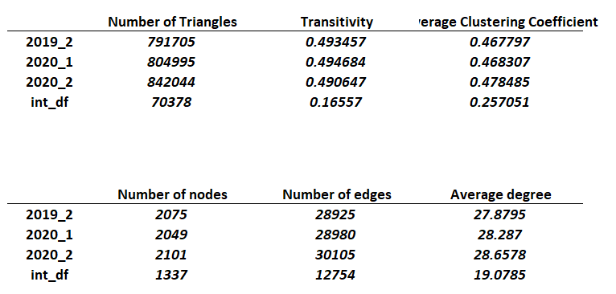
Edgelist
Edgelist1,edgelist2, edgelist3, joinededge (inner joined all 3 edgelists)
Used for graph analysis

Slide 9
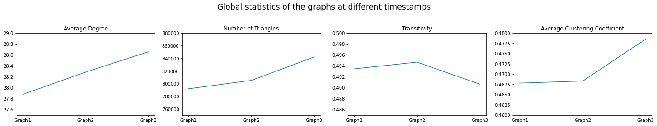
Edgelist info graphs (without joinededge)
We found an average 0.39 increase between each graph in the average degree of the disease network as approaching the outbreak point of covid-19.
The number of triangles and the average clustering coefficient of the disease network had slightly increase between 2019_2 and 2020_1, and a significant increase happened between 2020_1 and 2020_2.
Moreover, a very tiny increase followed a big drop occurred in transitivity plot.

Slide 10
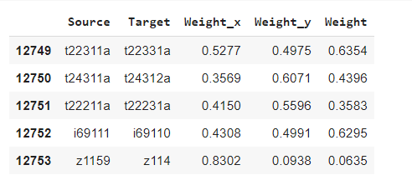
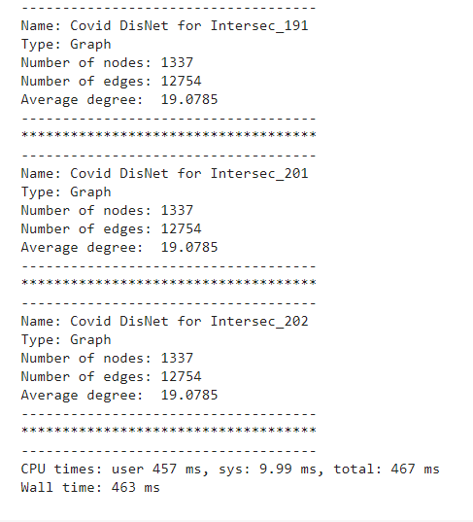
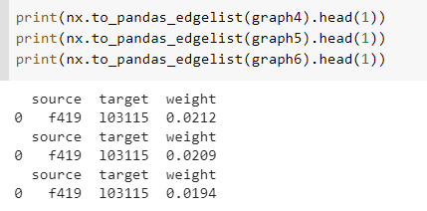
Problem with joinededge
Have trouble to reflect weight on graphs with same edges

Slide 11
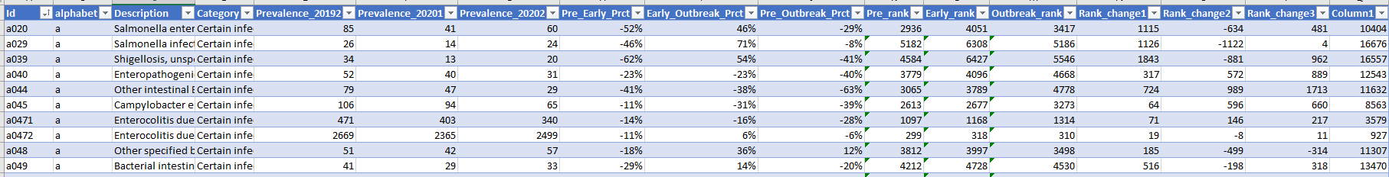
Prevalence Data
Performed feature engineering
This dataset is used to analyze the diseases that existed in all three periods. An inner join performed to generate this dataset.
Pre, Early, Outbreak represent timestamps of 201902, 202001, 202002 respectively.
Pre_rank, Early_rank, Outbreak_rank represent the rank of the disease in the corresponding period in terms of prevalence. The larger the prevalence number, the higher the rank is. When two or more diseases have same prevalence value, we assigned the higher rank to that set of duplicates.
Pre_Early_Prct, Early_Outbreak_Prct, Pre_Outbreak_Prct represent the prevalence percentage change between the periods.
Rank_change1, Rank_change2, and Rank_change3 represent the rank of the percentage change between the periods.

Slide 12
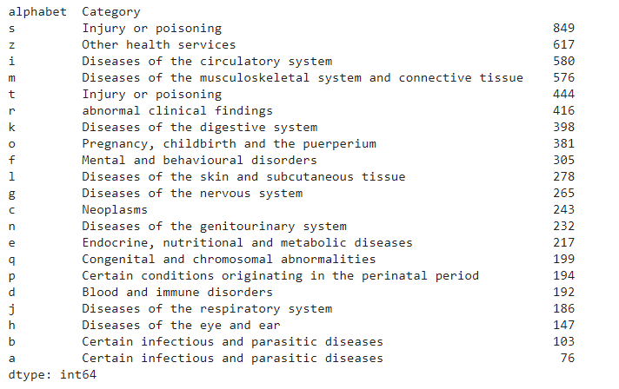
Prevalence Data
6898 diseases presented in the dataset, divided into 21 groups based on the first letter of icd10 code.

Slide 13
Agenda
•••••••••••••••••••••••••••••••••
Timestamp's clarification and aims & issues
Getting more data
Data we have so far & feature engineering
Analysis

Slide 14
Analysis
•••••••••••••••••••••••••••••••••
What I have done
Prevalence analysis
Graph comparison
Weights comparison
Next step
Graph summary (Michigan state paper)

Slide 15
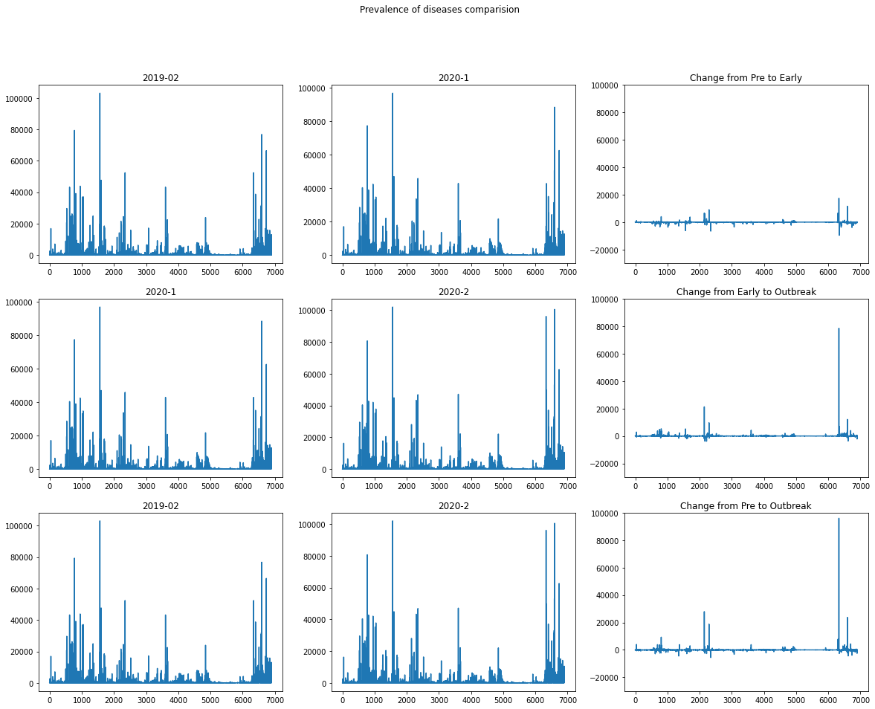

Slide 16
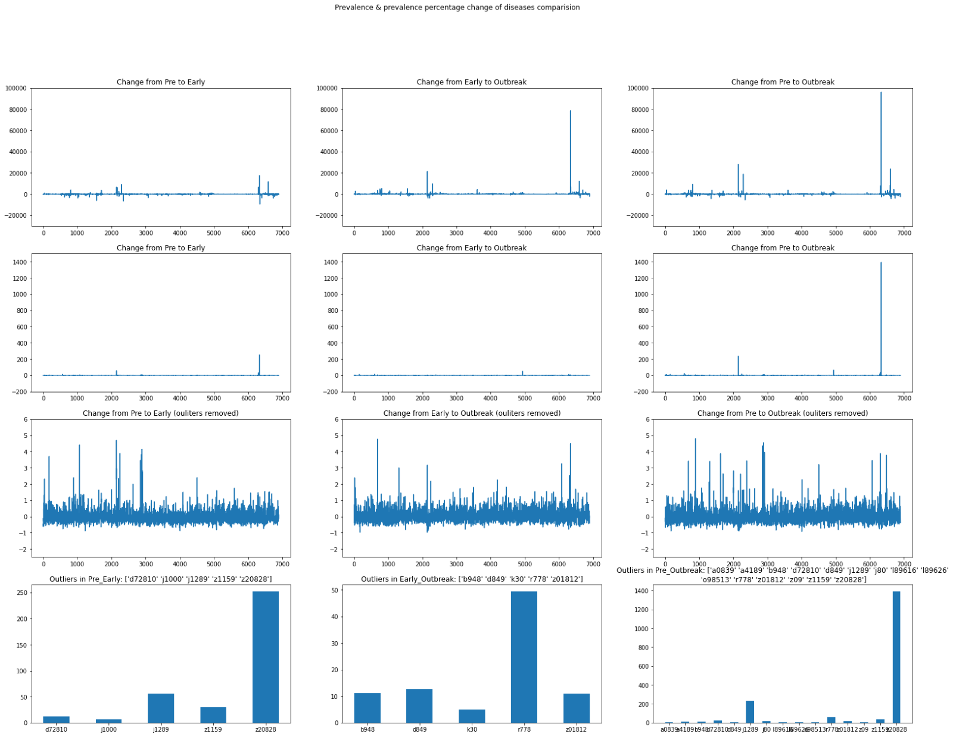
(We need to compare the normal vs. Normal periods; maybe need the following month during the pandemic)
The graphs in the first row are the number of reported diseases changed between periods.
The second row are the percentage change.
The third row shows the percentage change without outliers (>500%).
The last row shows the outliers, and the plot titles shows the icd10 code of those outliers. The scales of the fourth row’s graphs are different.

Slide 17
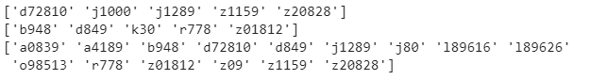
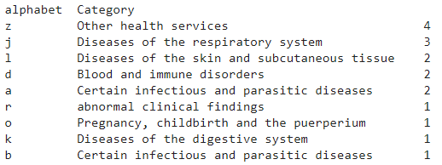
outliers to investigate

Slide 18
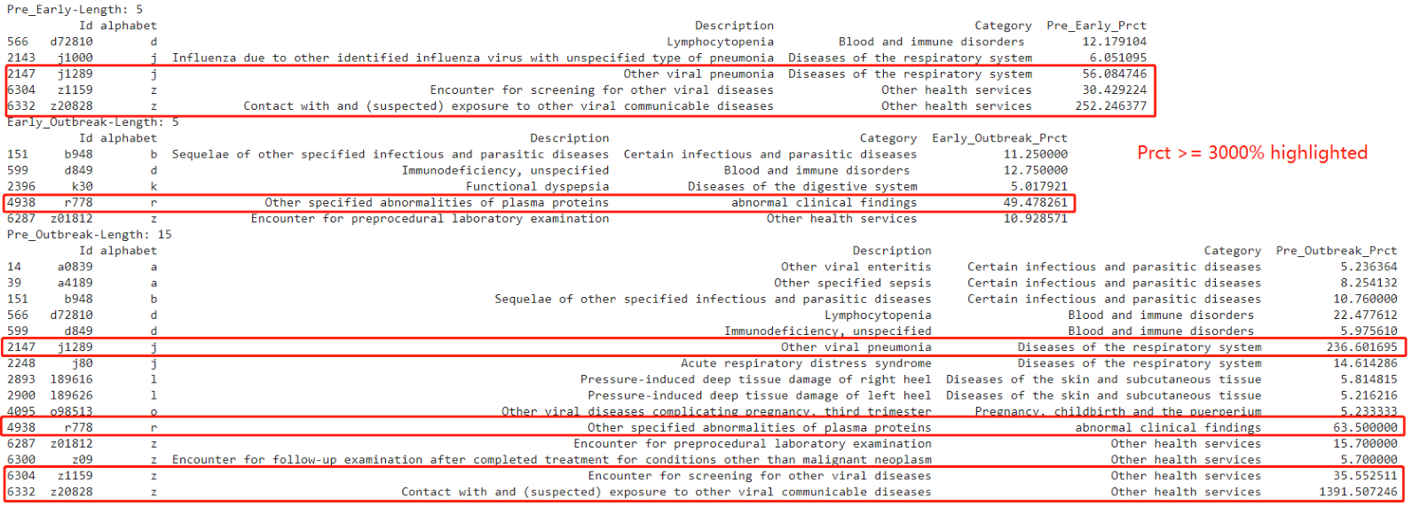
And if we break it down, we can see this:

Slide 19
Negative/positive growth
I also investigated the positive and negative change between the periods:
Between the pre and early periods, there were 4358 negative growths and 2540 positive growths.
Between outbreak and early periods, 3023 negative growths and 3875 positive growths.
Between outbreak and pre periods, there were 4020 negative growths and 2878 positive growths.
We can see that after entering the 20201 (early) period, a huge portion of the diseases were being under reported from the 20191 (pre) periods.
(So far, in this session, we haven't used the rank information. And I assume more consecutive data may help with comparison.)

Slide 20
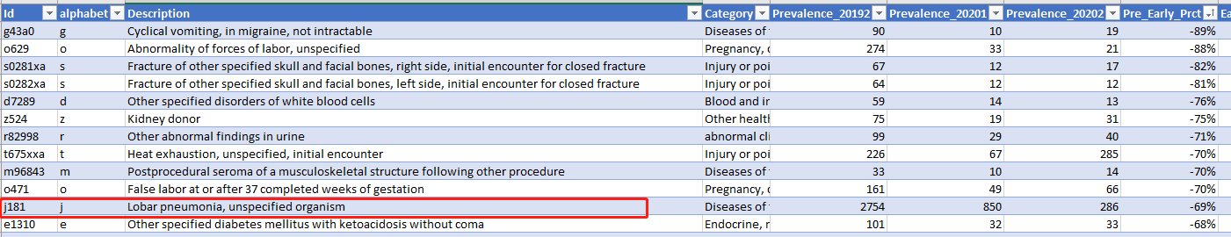
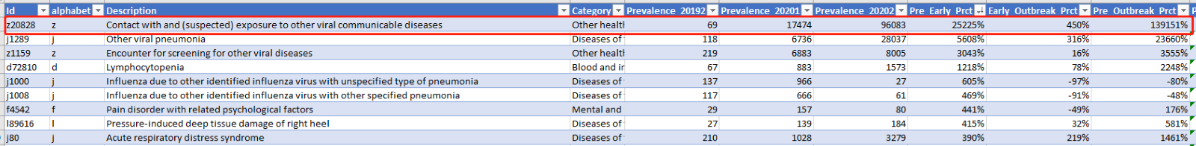
Graph comparison
Only 1275 pairs of nodes or edges existed in all three graphs.

Slide 21
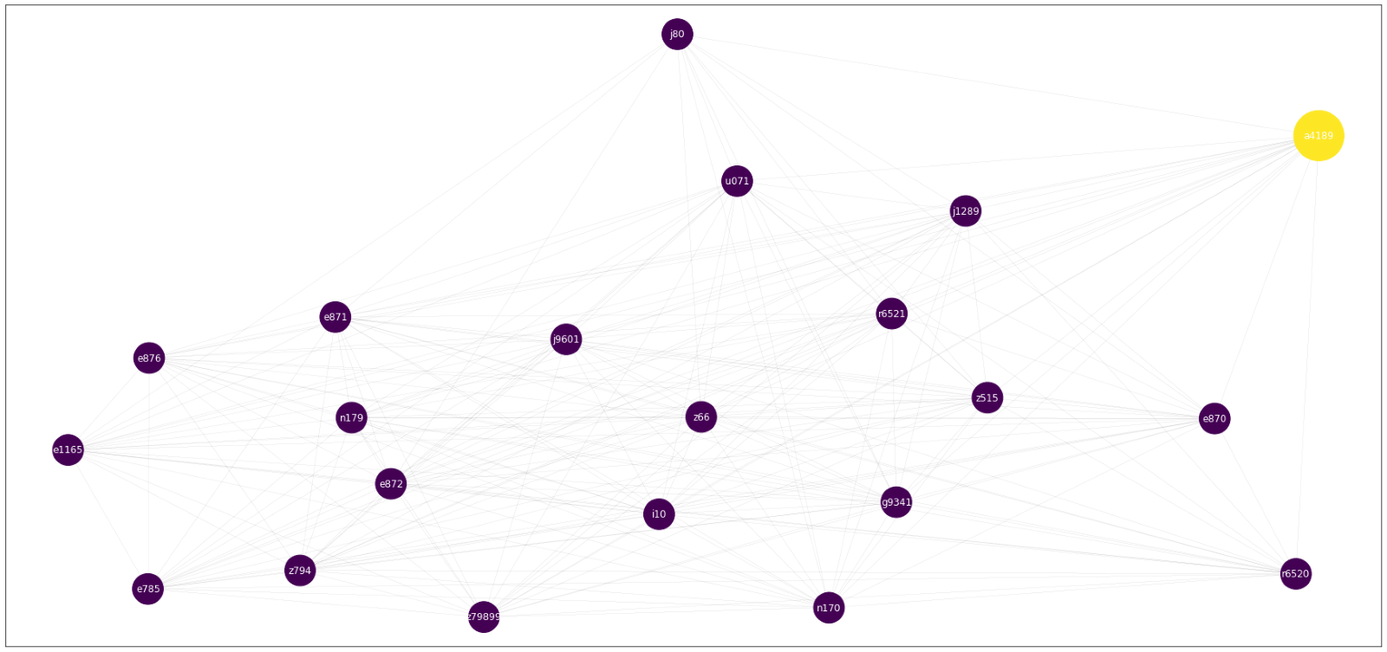
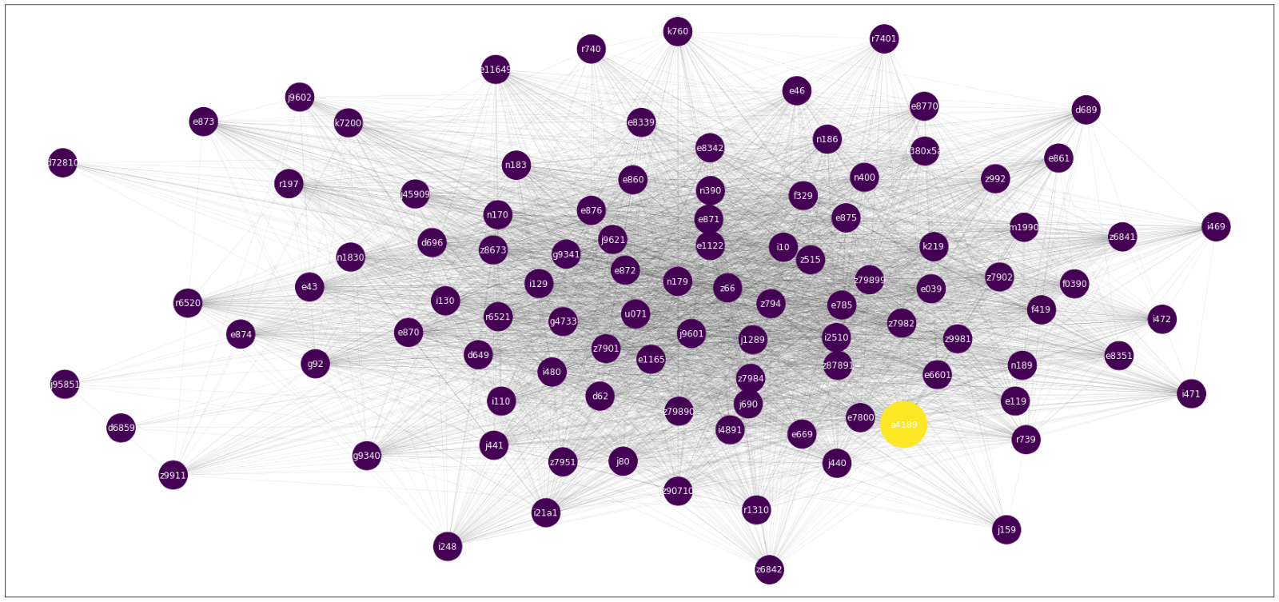
‘a4189’ (Sepsis occurs when chemicals released in the bloodstream) in early & outbreak graphs

Slide 22
“i4821”
Permanent atrial fibrillation (heart related) existed in all three graphs and had an 108% increase between pre and early
COVID-19 associated atrial fibrillation: Incidence, putative mechanisms and potential clinical implications

Slide 23
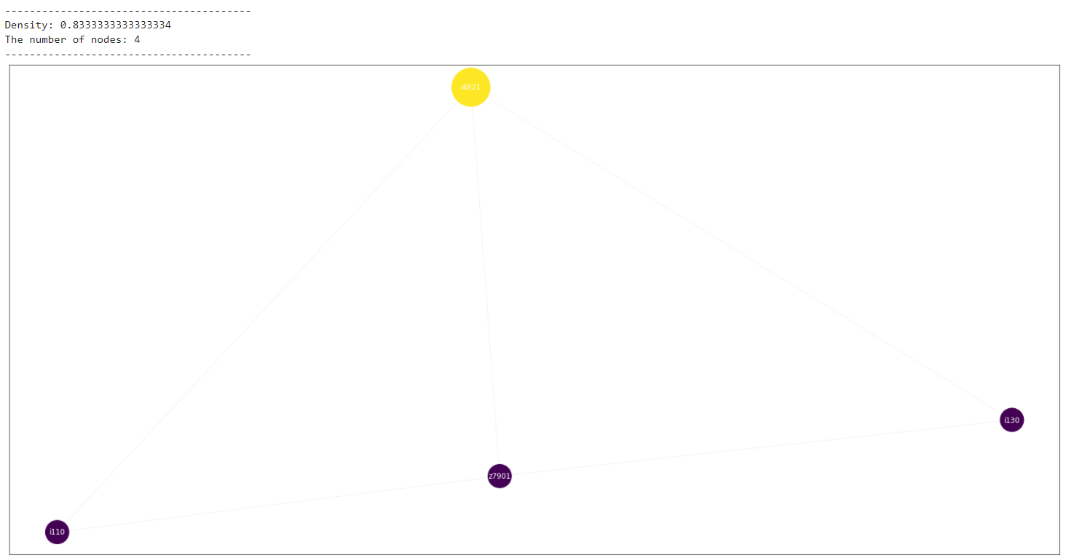
“i4821” - pre

Slide 24
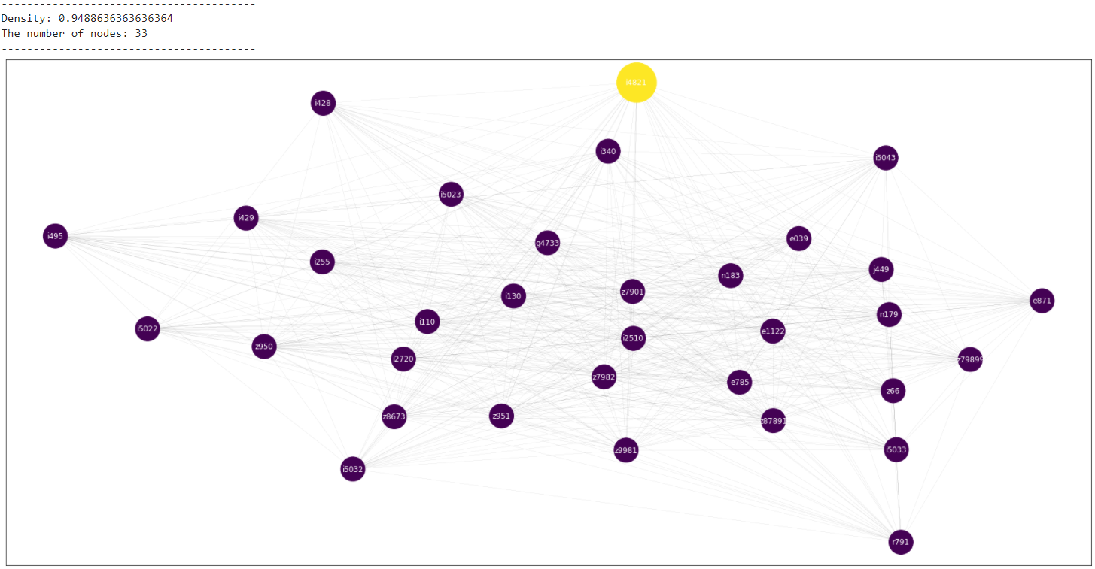
“i4821” - early

Slide 25
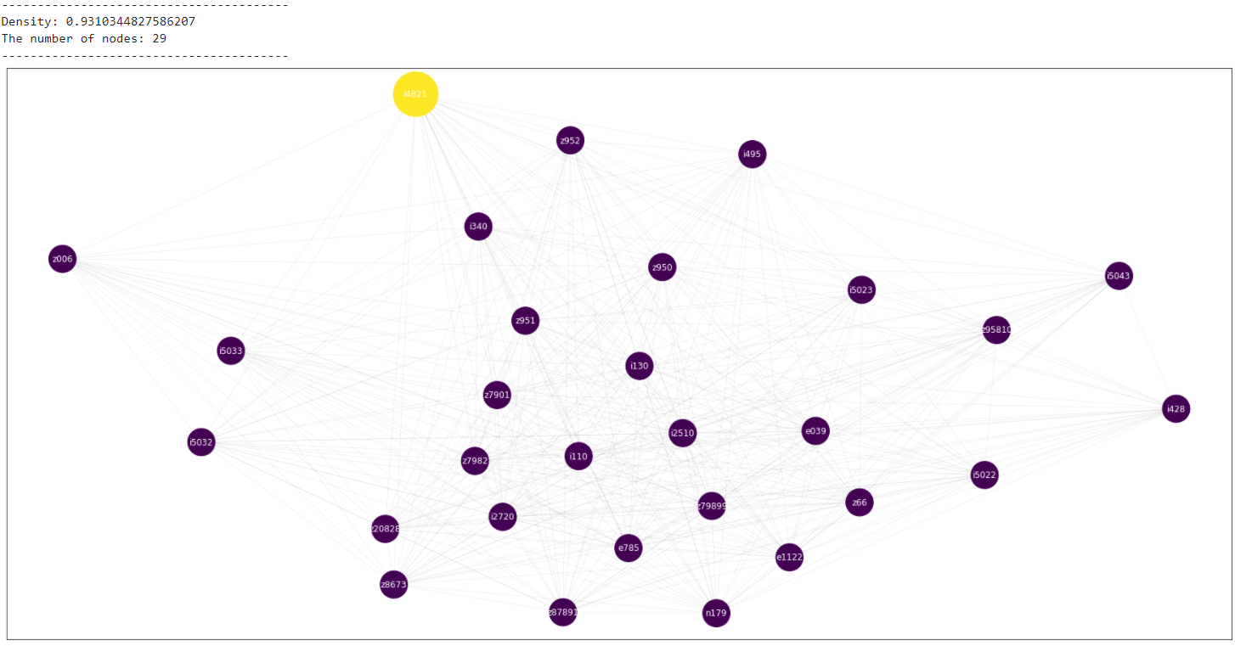
“i4821” - outbreak

Slide 26
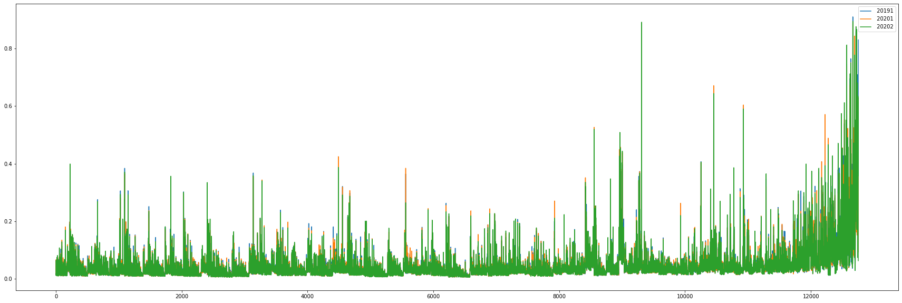
Weights comparison

Slide 27
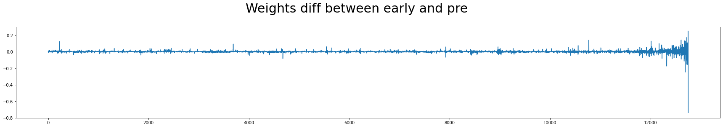
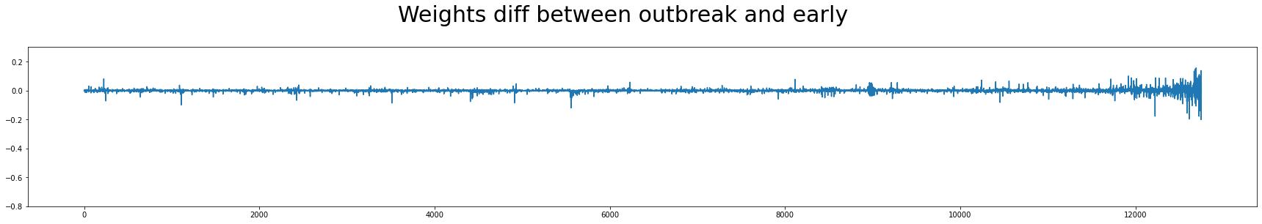
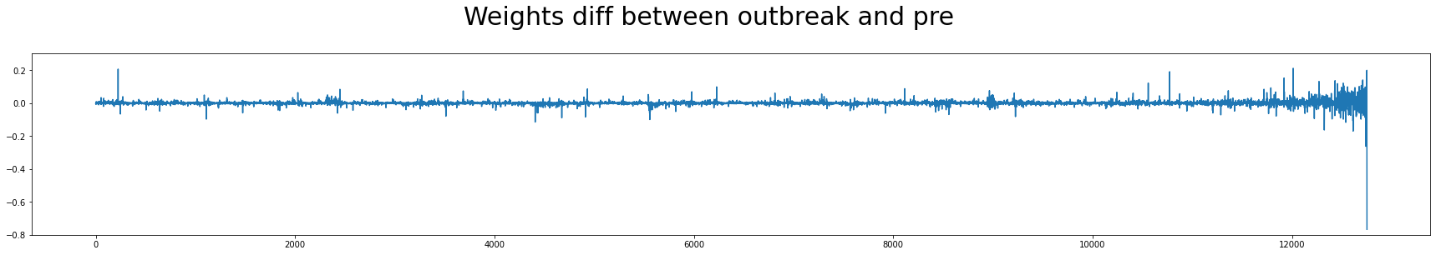

Slide 28

Thanks
Hope you liked the deck

